Slide 1
Master-Clinic
Software Engineering Project

Slide 2

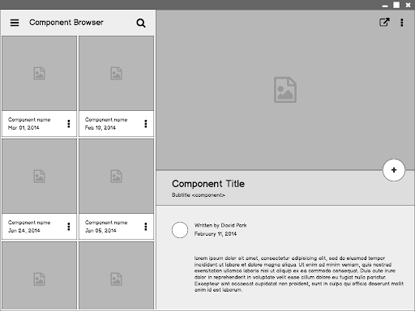
Intro
Master-Clinic is a web-based system designed to help doctors run their clinics efficiently by easily storing necessary information about their clients and performing conventional tasks.

Slide 3
Admins
They are either owners of the clinics called super admins or just assistant doctors working there.
Admins manage everything in relation with the clinics ,this includes the clinics themselves, patients and their medical files ,nurses ,workers and invoices...etc
Super admins can change admins data or remove them from clinics.

Slide 4
Nurses
Nurses work at clinics and are given some
administrative privileges to manage clients
data on behalf of Admins .
Nurses mainly manage the reservation
system in the clinic by reviewing client’s
reservations and confirming or rejecting.
them.
They also manage client’s data and invoices

Slide 5
Clients
Clients are the patients who have visited a clinic at least once.
They login primarily to make
a reservation with a doctor
at any clinic and date they
choose and they can know if
their reservation has been
accepted or rejected.
Clients also can contact their doctors by email and receive from them as well.

Slide 6
Other Entities
Clinics, This entity hold information about every clinic like name,telephone..etc
Workers, People who work at the clinics and are not nurses or doctors like the receptionist.
Receipts
Reservations
Categories
Materials
Client’s file (Images , Prescription , Comments)

Slide 7
Thanks!

